Slide 1


Atliq Mart Promotional Campaign Analysis
A Codebasics Resume Project Challenge
By- Aman Pratap Singh
( aka Peter Pandey )

Slide 2
CONTENTS
Introduction & Problem Statement
Tools Used
Source Data & Relationship-Entity Diagram
Key Metrics
Adhoc Business Requests
Recommended Insights
Summary
Project Links

Slide 3
INTRODUCTION:
Atliq Mart is a retail giant with over 50 supermarkets in the southern region of India. All their 50 stores ran a massive promotion during the Diwali 2023 and Sankranti 2024 (festive time in India) on their Atliq branded products.
The industry domain is FMCG.
PROBLEM STATEMENT:
Analyse promotions and provide tangible insights in order to make more informed decisions over the next promotional period

Slide 4
TOOLS USED:
MySQL Workbench: Creating SQL queries for ad-hoc business requests.
PowerBI: For Data cleaning, modelling, creating metrics using DAX and data visualization.
PowerPoint: For creating background themes for the PowerBI reports in SVG format & Presentation.
.

Slide 5
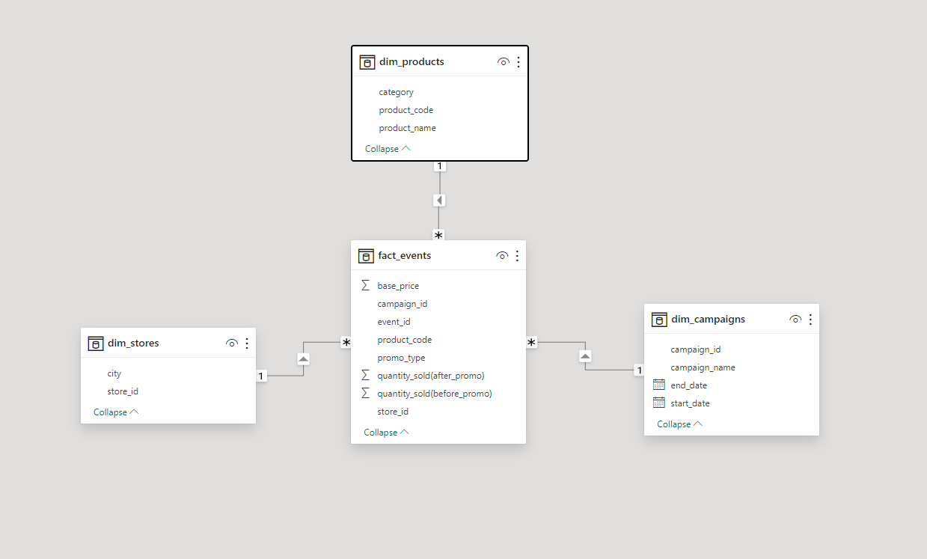
SOURCE DATA & RELATIONSHIP ENTITY DIAGRAM:
The 4 datasets provided are in the CSV file format.
There are 3 dimension tables namely, dim_campaigns, dim_products and dim_stores and 1 fact_table which is fact_events.
Relationship Schema

Slide 6
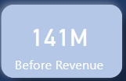
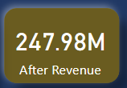
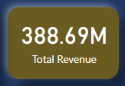
KEY METRICS:
The key metrics that have been used for the analysis of the sales and revenue of Atliq Mart are:
Before Revenue: This measures the revenue before the offer was applied.
Formula: (Base Price * Quantity Sold After Offer)
2. After Revenue: This measures the revenue after the offer was applied.
Formula: (Base Price * Promo type*Quantity Sold After Offer)
3. Total Revenue: This measures the total revenue, i.e., before and after the offer was applied.
Formula: (Before Revenue + After Revenue)

Slide 7
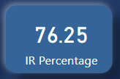
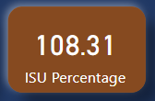
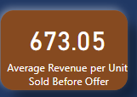
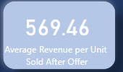
4. Incremental Revenue (IR): This measures the additional revenue generated as a result
of the promotional offer.
Formula: Incremental Revenue = (After Revenue-Before Revenue) / (Before Revenue) * 100%
5. Incremental Sold Units: This measures the additional units sold as a result of the promotional
offer.
Formula: Incremental Sold Units = (Quantity Sold After Offer - Quantity Sold Before Offer) /
(Quantity Sold Before Offer) * 100%
6. Average Revenue per Unit Sold Before Offer: This calculates the average revenue generated
per unit sold before the promotional offer is applied.
Formula: Average Revenue per Unit Sold Before Offer = (After Revenue / Quantity Sold
Before Offer)
Average Revenue per Unit Sold After Offer: This calculates the average revenue generated per unit sold after the promotional offer is applied.
Formula: Average Revenue per Unit Sold After Offer = (After Revenue / Quantity Sold After
Offer).

Slide 8
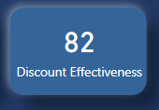
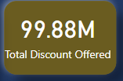
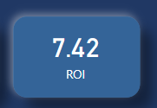
8. Discount offer: This metric signifies about the discount offered after the offer is
applied.
Formula: (Base price * Promo offer)
9. Discount Effectiveness: This metric evaluates the effectiveness of each discount offer in
driving sales.
Formula: Discount Effectiveness = ((Quantity Sold After Offer - Quantity Sold Before
Offer) / Discount Offer) * 100%
10. Total Discount offered: This represents the total discount offered on all the products.
Formula: Total Discount offered = (Discount offer* Quantity Sold After Offer)
11. Return on Investment (ROI) of the Promotion: This measures the return on
investment generated from the promotional campaign.
Formula: ROI = ((After Revenue – Before Revenue) - Total Promotional Cost) / (Total
Promotional Cost)
(Here, Total Discount offered is assumed to be Total Promotional Cost).
Note: The currency is in Indian Rupee. So, all the relevant metrics are according to Indian Rupee currency.

Slide 9

ADHOC BUSINESS REQUESTS:
There are 5 adhoc business requests and the subsequent information is extracted using MySQL.
PROBLEM 1: Provide a list of products with a base price greater than 500 and that are featured in promo type of 'BOGOF' (Buy One Get One Free). This information will help us identify high-value products that are currently being heavily discounted, which can be useful for evaluating our pricing and promotion strategies.

Slide 10
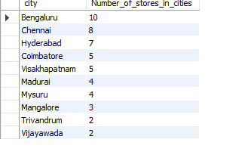
PROBLEM 2: Generate a report that provides an overview of the number of stores in each city. The results will be sorted in descending order of store counts, allowing us to identify the cities with the highest store presence. The report includes two essential fields: city and store count, which will assist in optimizing our retail operations.

Slide 11

PROBLEM 3: Generate a report that displays each campaign along with the total revenue generated before and after the campaign? The report includes three key fields: campaign_name, totaI_revenue(before_promotion), totaI_revenue(after_promotion). This report should help in evaluating the financial impact of our promotional campaigns. (Display the values in millions).

Slide 12
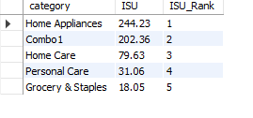
PROBLEM 4: Produce a report that calculates the Incremental Sold Quantity (ISU%) for each category during the Diwali campaign. Additionally, provide rankings for the categories based on their ISU%. The report will include three key fields: category, isu%, and rank order. This information will assist in assessing the category-wise success and impact of the Diwali campaign on incremental sales.

Slide 13
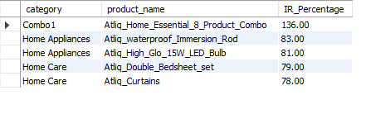
PROBLEM 5: Create a report featuring the Top 5 products, ranked by Incremental Revenue Percentage (IR%), across all campaigns. The report will provide essential information including product name, category, and ir%. This analysis helps identify the most successful products in terms of incremental revenue across our campaigns, assisting in product optimization.

Slide 14
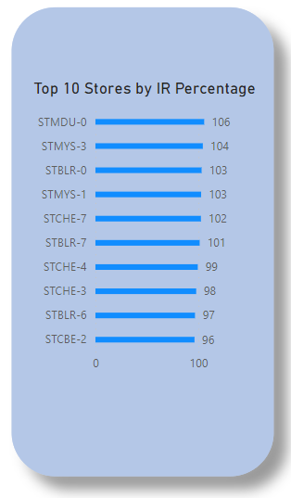
RECOMMENDED INSIGHTS:
Now, the insights gathered from the analysis of the records of the Atliq Mart, is provided below:
Store Performance Analysis:
Which are the top 10 stores in terms of Incremental Revenue (IR) generated from the promotions?

Slide 15
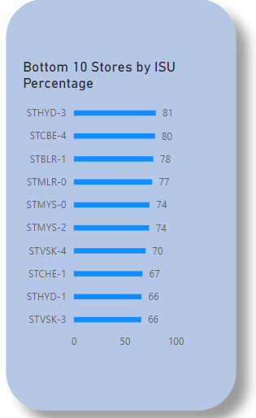
2. What are the bottom 10 stores when it comes to Incremental Sold Units (ISU) during
the promotional period?

Slide 16
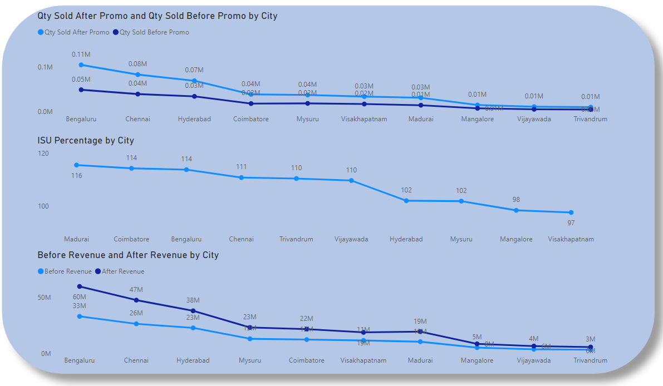
3. How does the performance of stores vary by city? Are there any common characteristics among
the top-performing stores that could be leveraged across other stores?
Common characteristics among the top revenue generating cities are the number of store counts which are more in these as compared to rest of the cities.

Slide 17
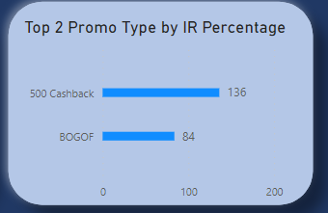
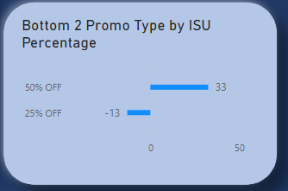
Promotion Type Analysis:
1. What are the top 2 promotion types that resulted in the highest Incremental Revenue?
2. Which the bottom 2 promotion types in terms of their impact on Incremental Sold Units?

Slide 18
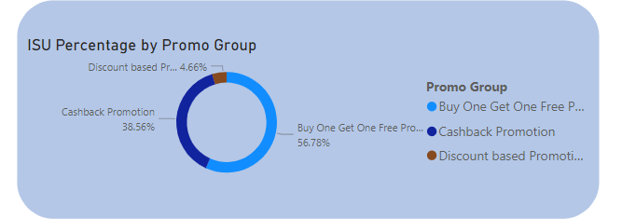
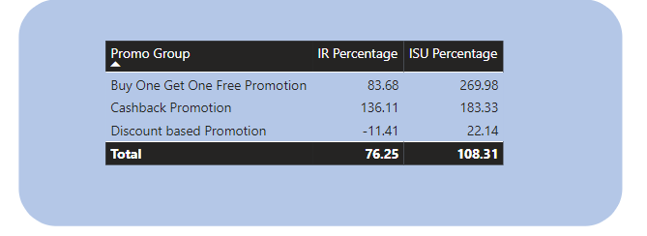
3. Is there a significant difference in the performance of discount-based promotions versus BOGOF (Buy One Get One Free) or cashback promotions?
4. Which promotions strike the best balance between Incremental Sold Units and maintaining healthy margins?
Cashback Promotion

Slide 19
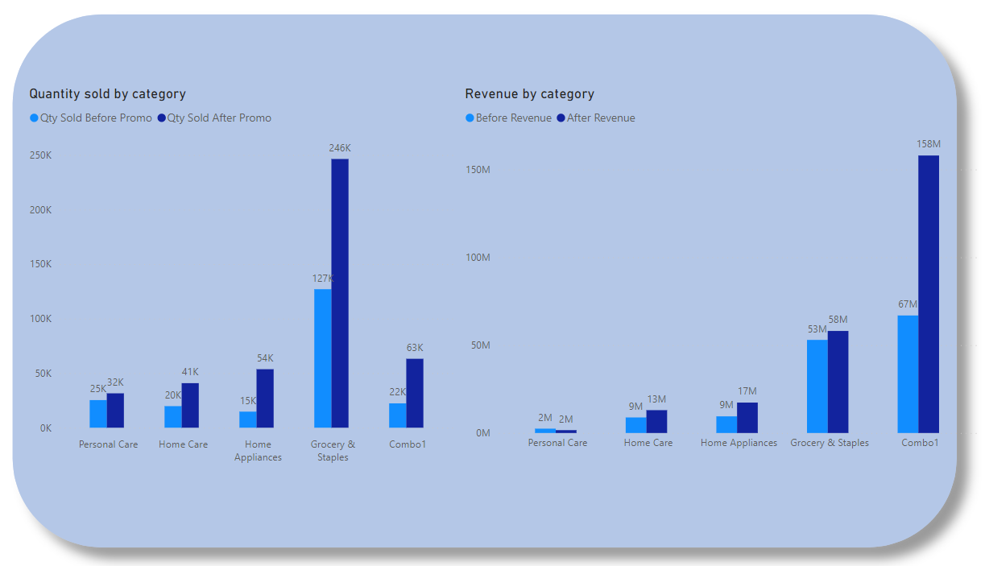
Product and Category Analysis:
Which product categories saw the most significant lift in sales from the promotions?
Combo 1 and Grocery and Staples stand out as the top revenue-generating categories post-offer
Home Appliance category possess the highest ISU, indicating that its products sold more than the other categories.

Slide 20
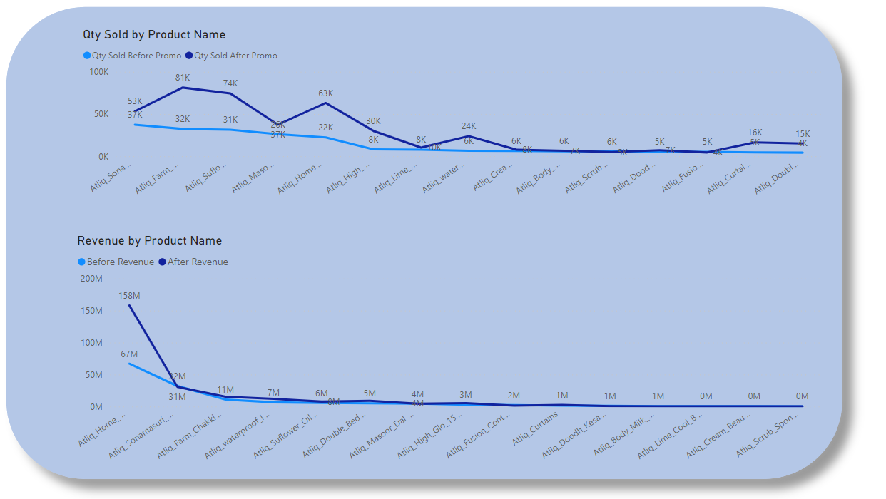
2. Are there specific products that respond exceptionally well or poorly to promotions?
Atliq Scrub Sponge for Dishwash, Atliq cream beauty bathing soap(125 gm), Atliq lime cool bathing bar(125 gm), Atliq body milk nourishing lotion(120 ml), Atliq doodh kesar body lotion(200ml).
had the minimal impact of the campaign
Atliq home essential & product combo, experiences a major positive impact.

Slide 21
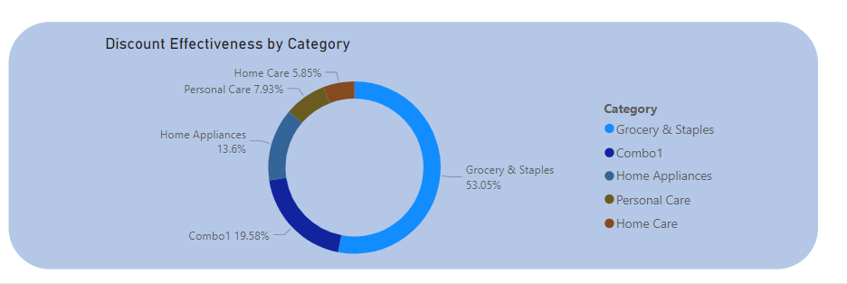
3. What is the correlation between product category and promotion type effectiveness?
Grocery and staples benefited the maximum with the promotional offers while Home care experiencing the least impact.

Slide 22
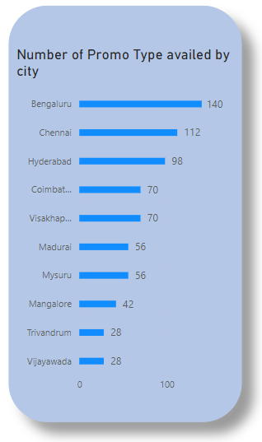
Additional Insights:
1.
Bengaluru, Chennai and Hyderabad availed the most offers due the fact that there are more number of stores in these cities as compared to Trivandrum and Vijawada, which have the least number of stores.

Slide 23
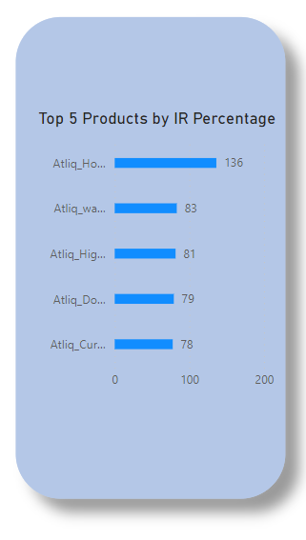
2.
Atliq_home_essential_&_product_combo product generates the highest incremental revenue of 136%.

Slide 24
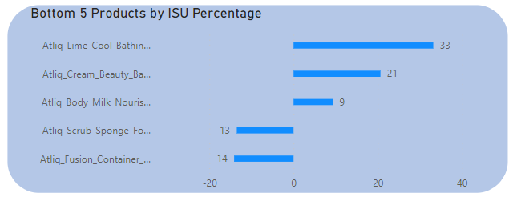
3.
Atliq_fusion_container_set_of_3 and Atliq_scrub_sponge_for_dishwash are the least sold products.

Slide 25
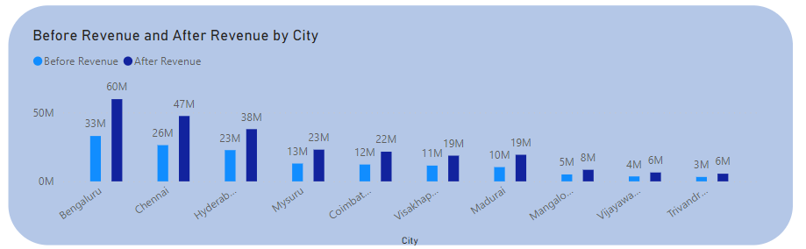
4.
Bengaluru, Chennai, Hyderabad, Mysuru and Coimbatore are the top 5 cities from where around 70-75% of the revenue is generated before and after the offer.

Slide 26
5. The before revenue, after revenue and the total revenue for both the campaigns (Diwali and Sankranti) combined are 141 million, 247.98 million and 388.69 million respectively (currency unit is Indian Rupees). Thus, having a positive impact by promotional offers.
6. The average revenue per unit sold before the offer is Rs. 673.05 and the average revenue per unit sold after the offer is Rs. 569.46. When the average revenue per unit sold after the offer is less than the average revenue sold before the offer, but the total revenue after the offer is applied is more than the total revenue before the offer, it suggests a few potential scenarios for the business:
Increased volume with lower margins.
Effectiveness of Promotions.
Potential long-term impact.
7. The ROI is 7 which suggests that for every unit of investment made, the business is generating seven units of return. This indicates that the business is likely performing well in terms of efficiency and profitability.

Slide 27
8. Discount effectiveness: A discount effectiveness of 82 suggests that the discounts offered have been highly effective in driving sales and generating revenue after the discount was applied. Here's what this high discount effectiveness indicates about the discounts and products sold after the discount was applied:
Strong Customer Response
Effective Pricing Strategy
Increased Sales volume.

Slide 28
SUMMARY:
1. For Diwali, the revenue before the offer was Rs. 82.57 million while after the offer was applied, it was Rs. 160.29 million (an increase of 94% in revenue). For Sankranti, the revenue before offer was Rs. 58.13 million and after the offer was applied, the revenue turned out to be Rs. 87.70 million (an increase of 50.86% in revenue). Thus, Diwali is the most successful campaign among the two campaigns.
2. The ISU of Home appliance category is the highest, which means that products under home appliance category are sold much larger than the other product categories. However, Combo 1 and Grocery and staples are the categories, generating highest revenue after the offer, indicating that the promotional offer had a strong impact on these 2 categories.
3. Bengaluru, Chennai, Hyderabad, Mysuru and Coimbatore are the top 5 cities from where around 70-75% of the revenue is generated before and after the offer. This may be due to the higher number of stores present in these cities than the rest of the cities.
However, cities like Vijaywada and Trivandrum has showed immense potential as there revenue before and after the offer were increased by 1.5 times and 2 times respectively by only having store count of 2 in their cities. So, increasing the store count in these cities will generate more revenue from these cities.
4. BOGOF and Cashback promotions are more preferred by the customers than the Discount based promotions. Also, Cashback Promotions are the best promotions for striking the balance between incremental sold units and maintaining healthy margins.

Slide 29
PROJECT LINKS:
Medium:
https://medium.com/@amansingh010793/atliq-mart-promotional-campaign-analysis-codebasics-resume-challenge-9-3137cec0b0b9
novyPro (Dashboard Link) :
https://www.novypro.com/project/atliq-mart-promotional-campaign-analysis-codebasics-resume-challenge-9
Github (SQL Queries):
https://github.com/AmAn-1234567890/Atliq-Promotional-Campaign-analysis--Codebasics-challenge-9

Slide 30
THANK YOU

